Slide 1
SPAM SMS DETECTION
MOBILE APPLICATION
Students
Berkcan ÇELİK
Muazzez AYPEK
Sarper SİNANOĞLU
Emre GEDİKOĞLU
Advisor
Assistant Prof. Dr. Instructor Roya CHOUPANI
Co-Advisor
Dr. Instructor Faris Serdar TAŞEL

Slide 2
Contents
The Problem
Solution
Which method did we use?
How was the data that we worked on?
Technologies
Working principle of the system
Conclusion
Acknowledgements

Slide 3

The Problem
Determine if the received
message is spam SMS

Slide 4
Solution
React Native
React Native is a JavaScript based mobile application development tool
Naïve Bayes
Naïve Bayes is a supervised machine learning classification algorithm

Slide 5

Which method did we use?
We used the Naive Bayes classification method to find out which SMS’s are spam and which SMS’s are ham. While using this method, we did text analysis. So, we analyzed text messages based on the words we taught, and as a result, we determined whether the user’s SMS were spam.

Slide 6

How was the data that we worked on?
Number of SMSs taken : 5574
Number of Spam SMSs : 749
Number of Ham SMSs : 4825

Slide 7



Technologies
Technologies Used:
Python
React Native
MySQL

Slide 8
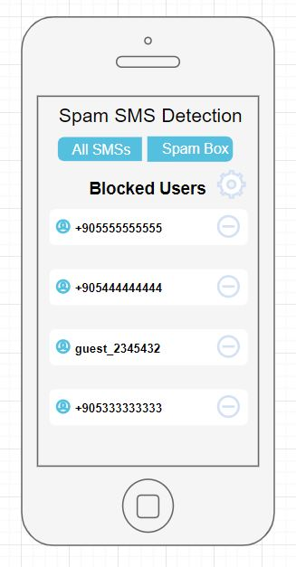
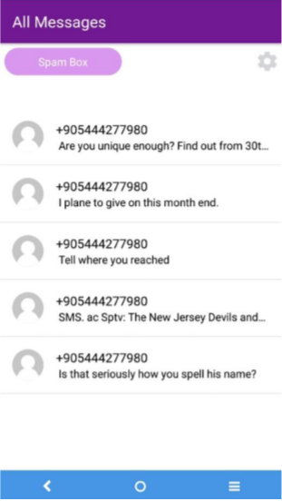

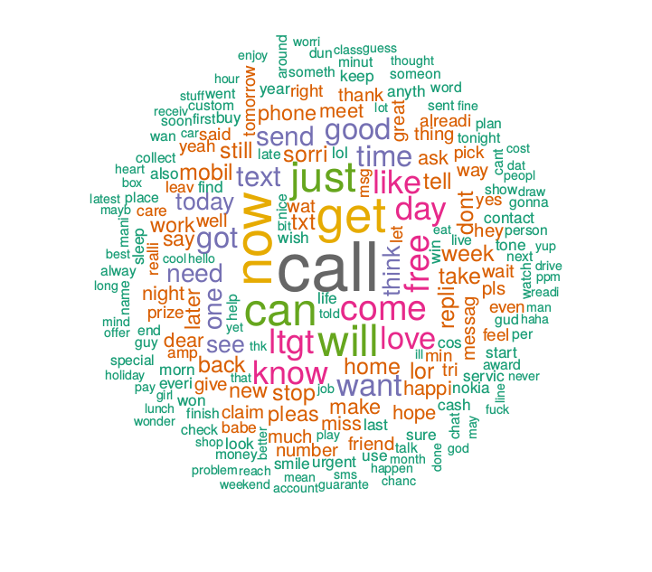
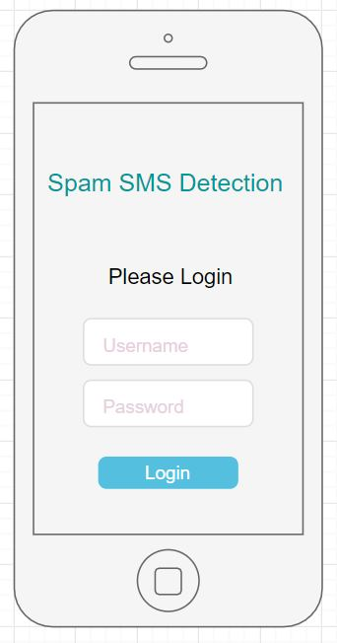
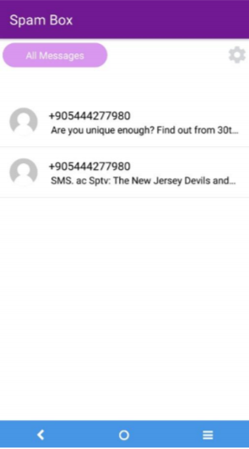
Working principle of the system:
All SMSs
to your inbox.
Incoming SMS
Spam SMS Detection
Using Naive Bayes Method
Spam SMSs to your Spam Box.

Slide 9
Conclusion
Spam SMS detection proves to be a significant topic for the telecommunication world in the modern day.
With this project, we aimed to efficiently utilize machine learning for the spam detection task.
In the future, we hope to further concentrate on the topic and come up with even brighter solutions which are responsive to the conflicts of the modern day telecommunication world.

Slide 10
Acknowledgements
We would like to thank our advisor Dr. Instructor Roya CHOUPANI for
her valuable and continuous guidance throughout our project.

Slide 11
DEMO
https://www.youtube.com/watch?v=M60SBFN5y70&feature=youtu.be

Slide 12




